Slide 1
Low Quality News Identification
Linfang Yang
Ricardo Frank Barrera
W266 – NLP Project

Slide 2

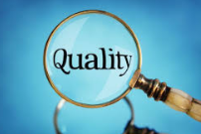
Data Sources
Yahoo News Dataset
Amazon reviews data
B.S. Detector
Kaggle (getting real about fake news)

Slide 3
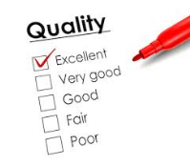
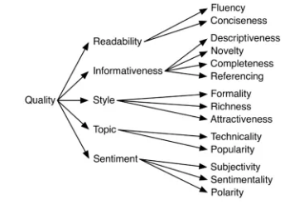
Yahoo News Quality Dataset
658 news articles and manual labels from professional linguist or editor.
14 aspects of news quality. Including 'Fluency', 'Conciseness', 'Descriptiveness', 'Novelty', 'Completeness', 'Referencing', 'Formality', 'Richness', 'Attractiveness', 'Technicality', 'Popularity', 'Subjectivity', 'Positive Emotion', 'Negative Emotion', 'Quality’.
Label is 1-5 score, labeled by professionals manually
1-3 = bad
4-5 = good

Slide 4
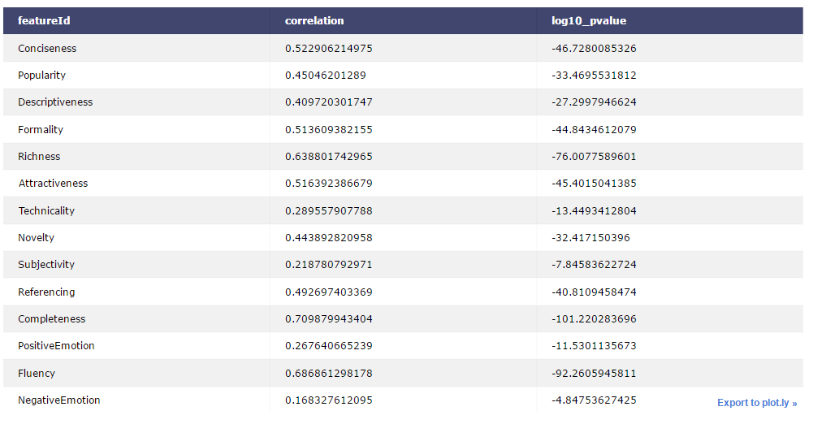

Slide 5
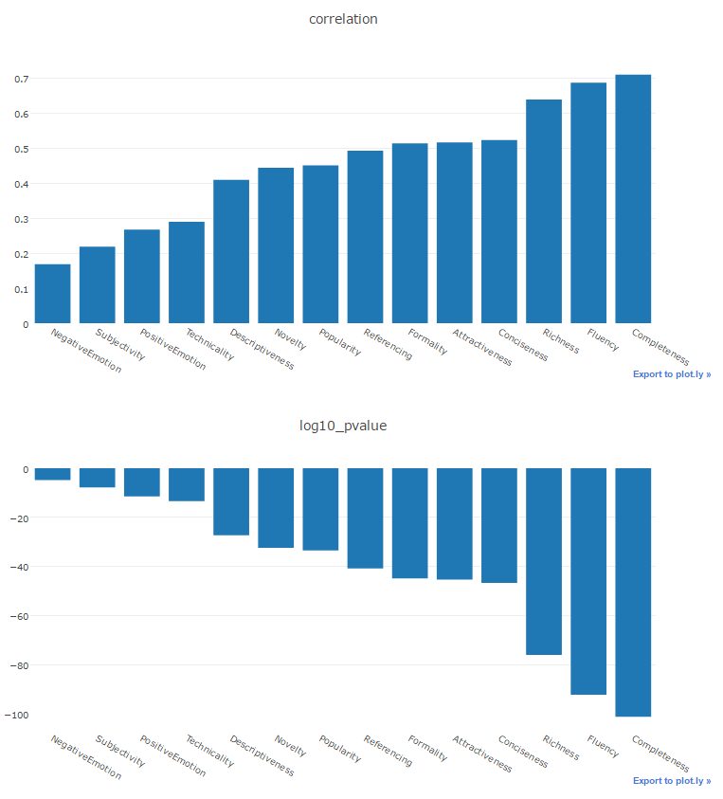
Correlation between attributes
Richness
Conciseness

Slide 6
Convolutional Neural Network model
First layer
embeds words in article content into low-dimensional vectors.
Second layer
performs convolutions over the embedded word vectors using multiple filter sizes.
Last layer
max-pool the result of the convolutional layer into a long feature vector
added dropout regularization and classify the result using a softmax layer

Slide 7
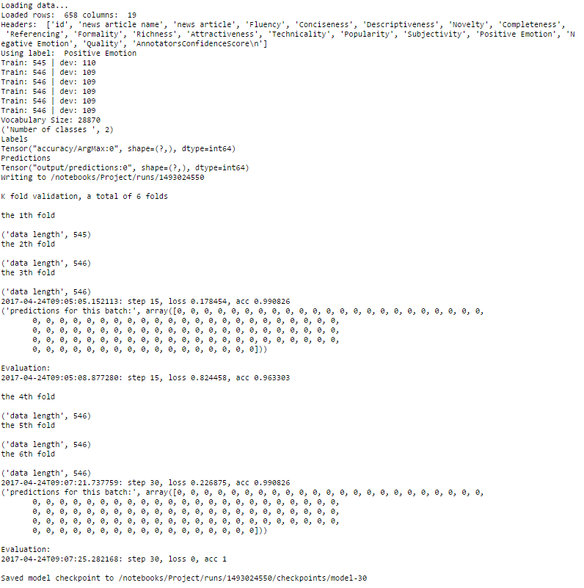

Slide 8
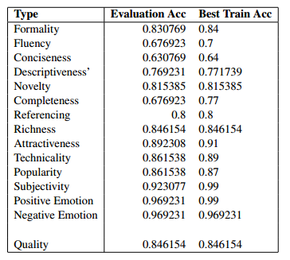
Training result phase one

Slide 9
Training result phase two

Slide 10

Model Evaluation
6 fold cross validation on training data
Making sure model works on training data
Moving on to 159 Facebook articles that are labeled as
Mostly true (5)
Mixture of true and false (3)
No factual content (2)
Mostly false (1)
1-3 = Bad; 4-5 = Good

Slide 11
Model training and evaluation

Slide 12
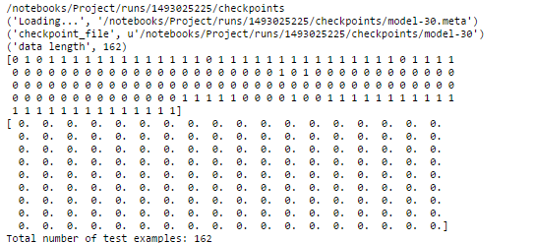
Future work
Increase training / evaluation dataset size
Include more article attributes in additional to text
Title/Domain Analysis
About the news source site analysis
Source Analysis
Writing Style Analysis
Aesthetic Analysis
Social Media Analysis

